Slide 1
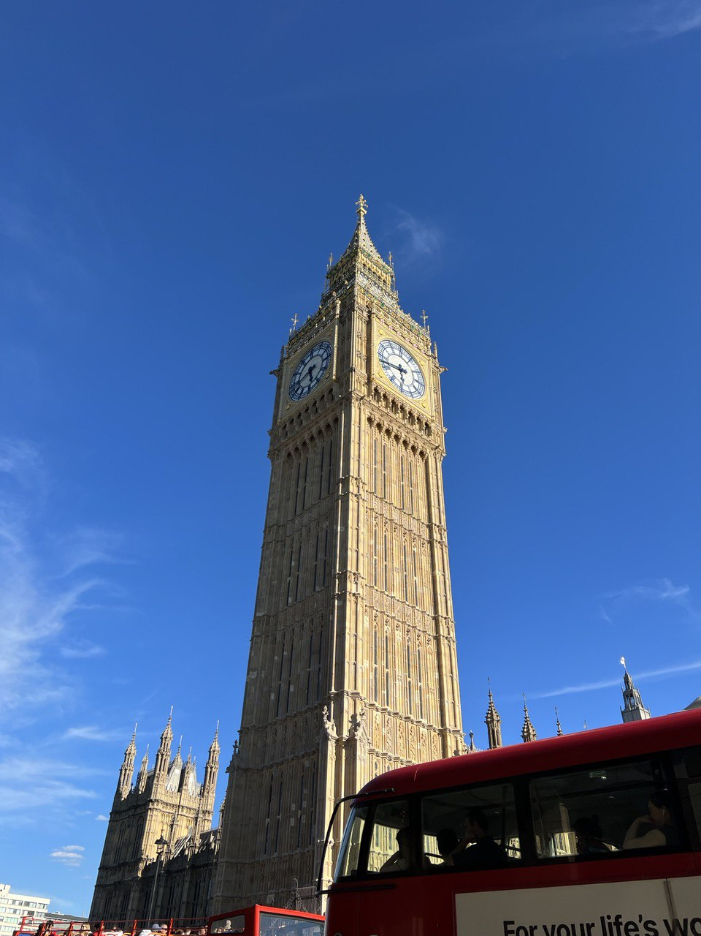
Moving to UK

Slide 2






Options
Ukrainian visa scheme
Family
Sponsorship
Working visa with relocation package
Relocation within company
New hire in big company

Slide 3
Motivation that I heard
Already know English, no need to learn German, French, any other language.
Cultural center in big cities.
A lot of job opportunities.
Possibly good schools. You may chose Dorset, Oxfordshire or some other county that you never heard before over London for family balance.
Fast 1-2 weeks sponsors response in April and May 2022 for Ukrainian visa scheme.

Slide 4
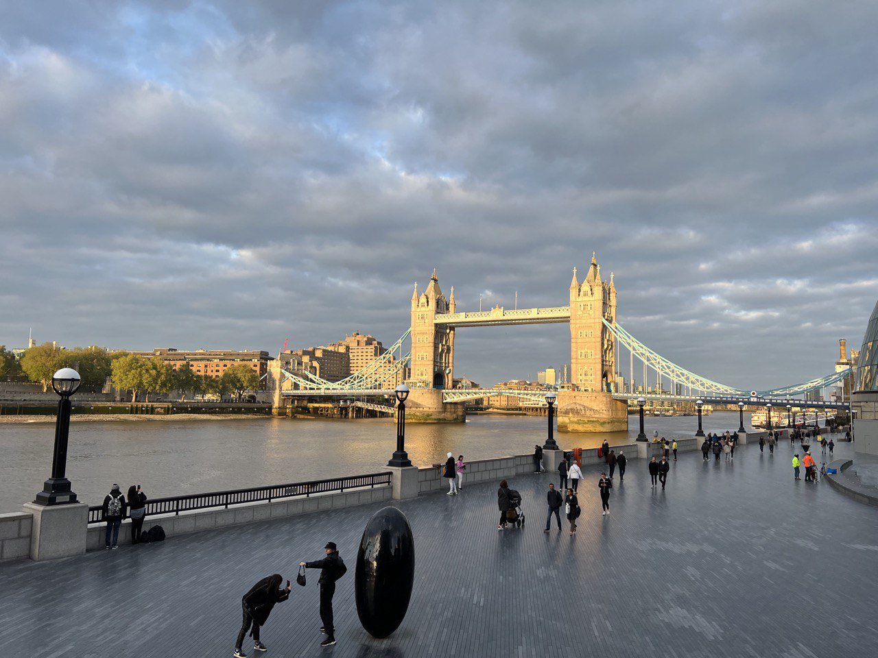
Thank you :)

